Slide 1
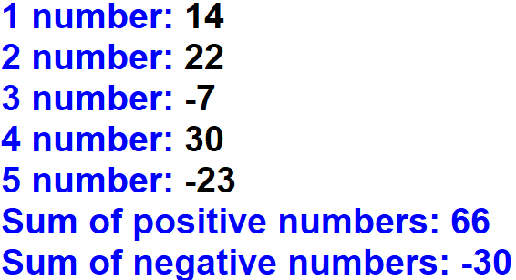
1. Write a program to ask from the user 5 numbers. Output the sum of positive numbers and the sum of negative numbers.
Output:

Slide 2
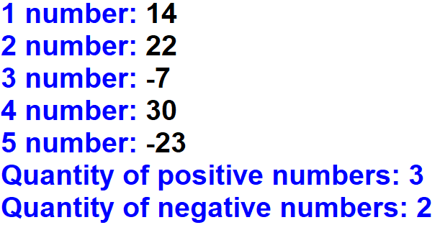
2. Write a program to ask from the user 5 numbers. Output the quantity of positive numbers and the quantity of negative numbers.
Output:

Slide 3
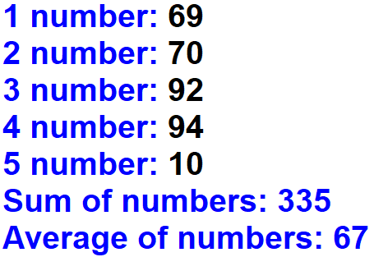
3. Write a program to ask from the user 5 numbers. Output the sum of numbers and the average of numbers.
Output:

Slide 4
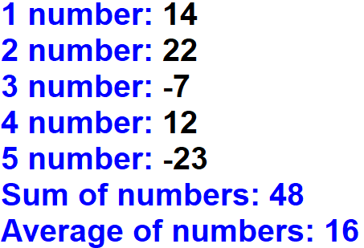
4. Write a program to ask from the user 5 numbers. Output the sum of numbers and the average of numbers, but don’t count negative numbers.
Output:

